Slide 1
Student Reviews Classification
Made by: 100609406

Slide 2
Data Source & Size
Course Reviews University of Waterloo
https://www.kaggle.com/datasets/anthonysusevski/course-reviews-university-of-waterloo.
This dataset has 14839 rows × 9 columns.

Slide 3


IT IS IMPORTANT TO FIND OUT AND COMPUTE EXPERIENCE OF STUDENT REGARDING A PARITUCLAR COURSE FROM QUALITY PERSPECTIVE. THE STUDENT REVIEWS DATASET WAS DONE TO IMPLEMENT COURSE REVIEWS AND QUALITY

Slide 4
PROBLEM STATEMENT
It is a big task to find out student opinion or reviews on each courses as it requires manual labor to under whether a review is liked or disliked
This project aims to use NLP techniques and train a classifier to classify a student review as ‘liked’ course or a ‘disliked course.

Slide 5
Column Descriptions
Course Code: Unique course code of each course rated by a student
Course Title: Title belonging to each course
Number of Ratings: Represents the total amount of ratings a particular course got
Useful: Represents the percentage of students who considered the course to be useful
Easy: Represents the percentage of students who considered the course to be easy
Liked: Represents the percentage of students who liked the course

Slide 6
Column Descriptions
Number of Reviews: Represents how many students gave a review for a particular course
Reviews: The textual response to a review given by a student for a particular course
Course Rating: This is our target variable. It represents whether a particular student "liked" a course or "disliked" a course.

Slide 7
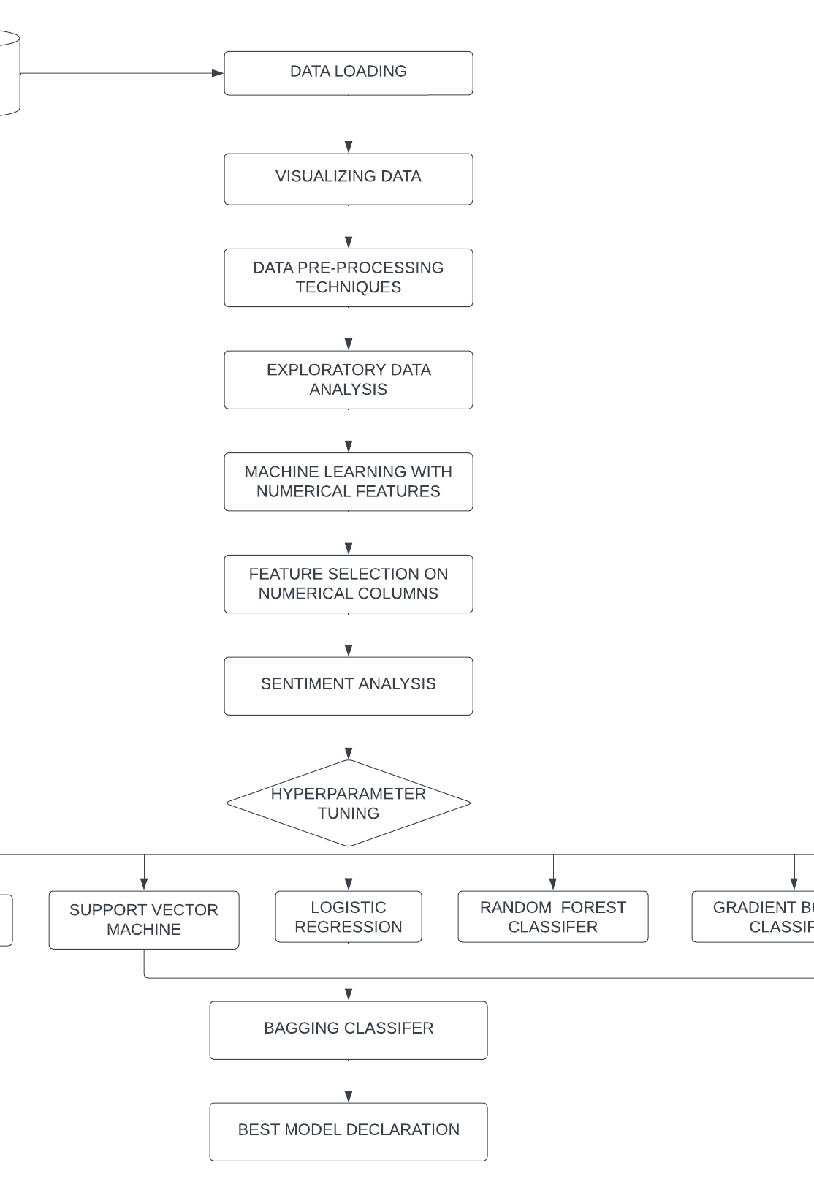
Methodology

Slide 8
Exploratory Data Analysis

Slide 9
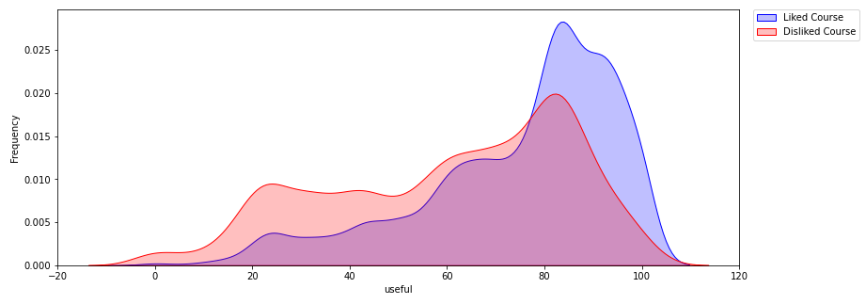
More students liked the course when percentage of students liking the course are higher.

Slide 10
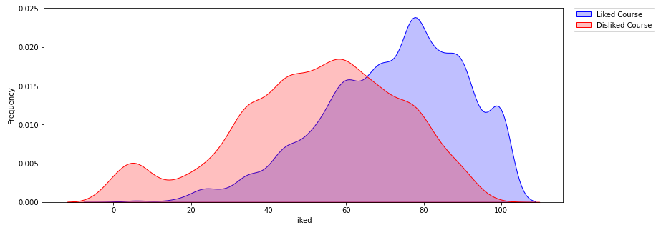
More students liked the course when the percentage of students who liked the course increased.

Slide 11
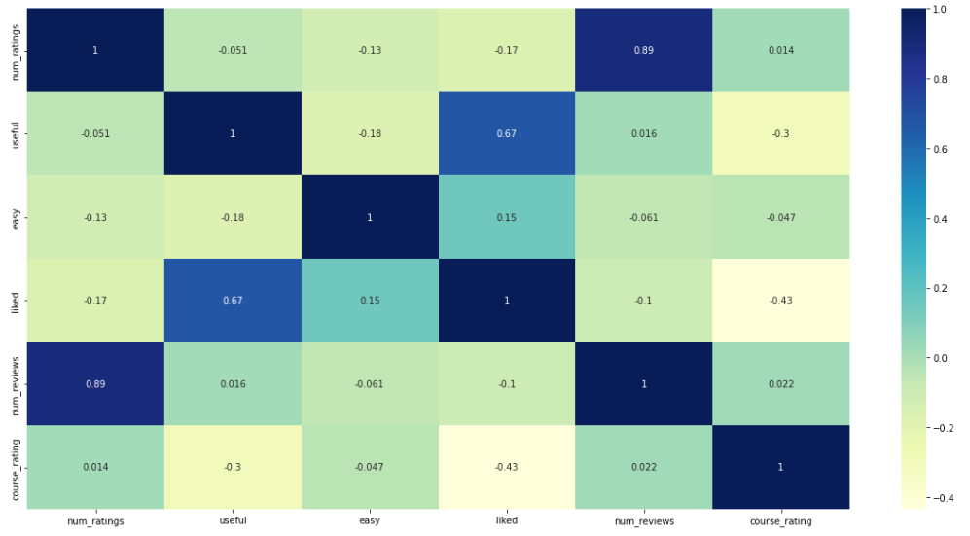
Negative correlation observed between course rating and useful, liked columns

Slide 12
Data Pre-Processing
Missing Value Analysis
Removing rows with missing values in target variable
Replacing missing values in reviews column with empty string
Replacing missing values in easy and liked column by mean
Replacing missing values in useful column by median
Data Cleaning
Removing % symbol from numerical columns
Label encoding course rating column (target variable)
Feature Scaling
Using Minmax Scaler to scale the features
Feature Reduction
Using Gradient Boosting Classifier as a feature selection technique to find out the best features

Slide 13
Evaluation Metric, Sentiment Analysis & Algorithms Used
Evaluation Metric
AUC-ROC was used as the evaluation metric for each model
Sentiment Analysis
Removing punctuations and lower casing reviews
Removing stop words. (if so etc.)
Stemming words to root form
Creating Bag of Words and count vectorizer to make review vectors
TF-IDF Transformation
Algorithms Used
Decision Tree Classifier
Logistic Regression
K-Nearest Neighbors
Random Forest
Gradient Boosting
Multinomial Naïve Bayes
Support Vector Machine
Voting Classifier
Neural Network(feedforward neural network (FNN))

Slide 14
Model Experimentation
Data
Features extracted from reviews column and liked column were used.
Data was split into train-test split with test size of 0.2
Stage 1: Base Model Development
Base models were fitted on the base version of each algorithm
Best performing models were selected for hyperparameter tuning
Stage 2: Hyper Parameter Tuning
Extensive hyperparameter tuning was performed.
Best algorithms with their best parameters were chosen for stage 3
Stage 3: Voting Classifier
All best algorithms with their best parameters were used to fit a voting classifier
This led to the best model developed
Stage 4: Optimum Probability Threshold
Best model was fitted, and optimum probability threshold was found out to balance predictions of both classes.

Slide 15
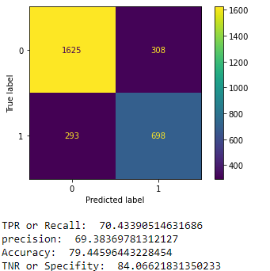
Best Model
Voting Classifier was used with base models
Logistic Regression
XGBoost Classifer
Random Forest
Gradient Boosting
Support Vector Machine
Best model was deployed on a probability threshold of 0.40 leading to the Confusion Matrix on the right

Slide 16
Refrences
Susevski, A. (2022, October 9). Course Reviews University of waterloo. Kaggle. Retrieved November 25, 2022, from https://www.kaggle.com/datasets/anthonysusevski/course-reviews-university-of-waterloo
Eddie_4072. (2022, June 20). Dealing with missing values in python. Analytics Vidhya. Retrieved November 25, 2022, from https://www.analyticsvidhya.com/blog/2021/05/dealing-with-missing-values-in-python-a-complete-guide/
Bhandari, A. (2022, June 14). AUC-Roc Curve in machine learning clearly explained. Analytics Vidhya. Retrieved November 25, 2022, from https://www.analyticsvidhya.com/blog/2020/06/auc-roc-curve-machine-learning/
Huilgol, P. (2022, June 14). Precision vs recall: Precision and recall machine learning. Analytics Vidhya. Retrieved November 25, 2022, from https://www.analyticsvidhya.com/blog/2020/09/precision-recall-machine-learning/

Slide 17

Thank You!

